Slide 1
Generative Adversarial Networks

Slide 2



REVIEW: NN
A linear model
$$a=w_{1}x_{1}+w_{2}x_{2}+…+w_{p}x_{p}+b$$
Decision based on $a$:
$$\begin{matrix}y=-1, & a<0 \\ y=+1, & a≥0\end{matrix}$$
bias
-1
Weights
Attributes
…
+1
Threshold-
Classification
Notes:
perceptron; multi-layer to make nn; figure out how to adjust parameters

Slide 3

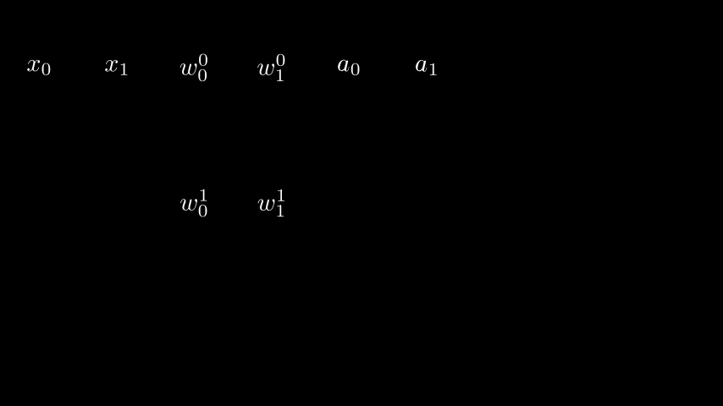
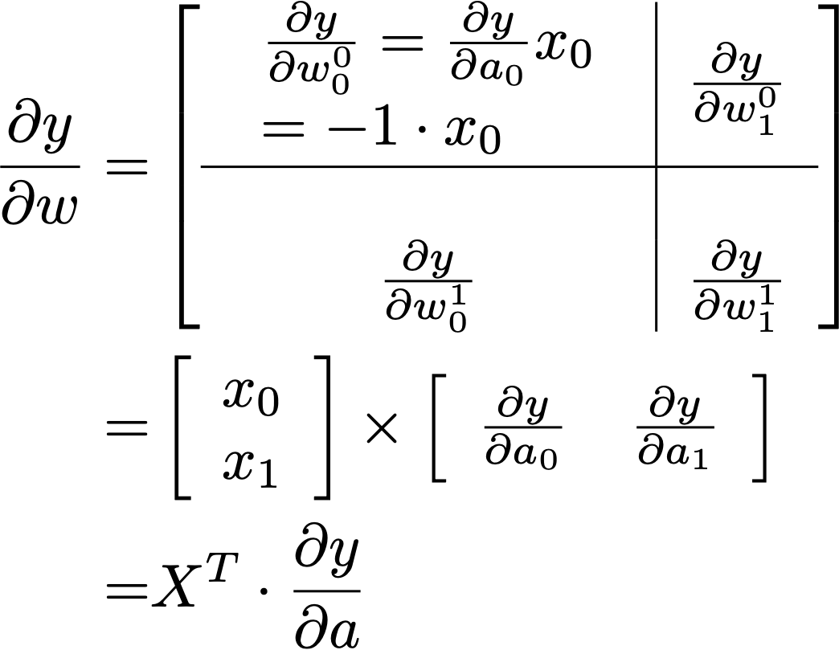
BP - 2a: A>>W
$$w_{0}^{0}$$
$$w_{1}^{0}$$
$$h_{0}$$
$$h_{1}$$
$$u_{0}^{0}$$
$$y_{0}$$
$$x_{0}$$
$$x_{1}$$
$$a_{0}$$
$$a_{1}$$
$$b_{0}$$
$$w_{0}^{1}$$
$$w_{1}^{1}$$
$$u_{0}^{1}$$
$$\begin{matrix} & \frac{∂y}{∂a}=[-1,0.5]\end{matrix}$$

Slide 4
The cost Intuitive expansion
The simple scheme does not work well practically.
…

Slide 5


Structures
Save Degrees of Freedom / Regularisation
Convolutional Neural Networks
Computation
Linear Op: conv. is linear

Slide 6
Structures
Convolutional Neural Networks
Linear Op: conv. is linear

Slide 7
MOD1: GAN MOTIVATED

Slide 8

GAN Motivation
What is the use of a probabilistic data model?
Posterior inference. E.g. (for classification)
if class-1, $p(x|c=1)$
if class-2, $p(x|c=2)$
Q: Behind the doors, 1 car 🚙, 2 sheep 🐑. After you have chosen a door. The organiser will open another door with a sheep behind it. The question is: should you change your choice? (See left as an example, A is chosen and C is opened).
HINT: Think the question by formulating the only factor that *out of your control and observable* as a random variable.
“Prob(Opened=C | A=🚙, B=🐑, Chosen=A)” and
“Prob(Opened=C | A=🐑, B=🚙, Chosen=A)”
A
B
C: 🐑
Notes:
e.g. if i just answer yes/no questions — I would be useful only if you know what to ask, — how can I express the knowledge more explicitly.

Slide 9
Probabilistic Modelling
Attempt 1
For every $x∈X$, model p(x)
3.1.1 Probabilistic Density (PDF) Function Approx.
# def
lin1 = nn.Linear(in_features=1, out_features=4)
lin2 = nn.Linear(in_features=4, out_features=1)
# forward
p = sigmoid((lin2(active(lin1(x)))) # prob in [0, 1]
…
for i in range(MAX_TRAIN):
pred = pdf_net_(x_trn)
loss = mse_loss(pred, y_trn)
loss.backward()
…

Slide 10
Probabilistic Modelling
Attempt 1
For every $x∈X$, model p(x)
Q: Your opinion about Attempt 1.
We should build probabilistic model like this.
No, because this is attempt-1 😅
No, we cannot compute loss over all $X$ for real data.

Slide 11
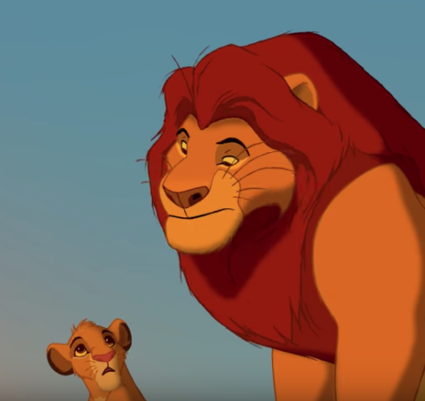

GENERATIVE Probabilistic Modelling
Motivation for generative models: Explicit expression of knowledge.
Everything the light touches is in our kingdom.

Slide 12

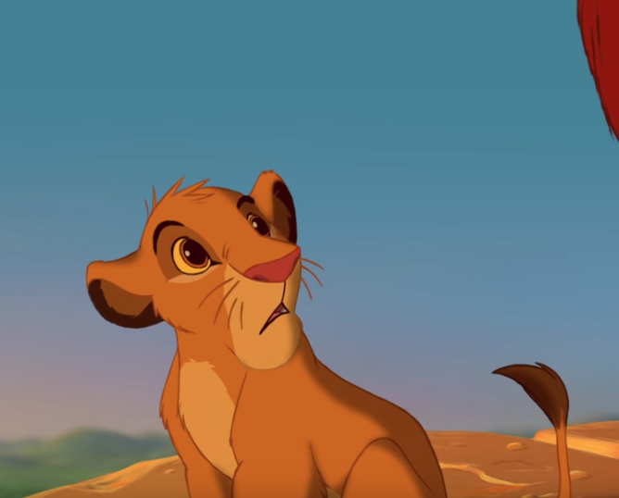
GENERATIVE Probabilistic Modelling
Motivation for generative models: Explicit expression of knowledge.
🦁👍
🦁👍
🦁👍
🦁❌
🦁❌
🦁👍
🦁👍
🦁❌
🦁👍
🦁❌
🦁❌
🦁👍
What about that shadowy place?

Slide 13


Probabilistic Modelling
Attempt 2
Let us generate samples in $X$. We start by guessing.
L1
L2
L3
random_input
$$R^{4}$$
$$R^{4}$$
fake_x
3.1.2.Generator
# def:
lin1 = Linear(in_features=1, out_features=4)
lin2 = Linear(in_features=4, out_features=4)
lin3 = nn.Linear(in_features=4, out_features=1)
# forward(…):
random_input = torch.rand()
out = lin3(activ(lin2(activ(lin1(random_input)))))

Slide 14

Probabilistic Modelling
Attempt 2
Generate samples in $X$ - Then adjust model to maximise $p(x_{fake})$
L1
L2
L3
LOSS $p(⋅)$
random_input
$$R^{4}$$
$$R^{4}$$
fake_x
3.1.2.Generator-Naive Improve
# backward(…):
fake_x = model_g(random_input)
fake_prob = logpdf_fn_t(fake_x.squeeze())
loss = - fake_prob.mean()
loss.backward()
# adjust model according to grad
optim_g.step()

Slide 15
Probabilistic Modelling
Attempt 2
Generate samples in $X$ - Then adjust model to maximise $p(x_{fake})$
L1
L2
L3
LOSS $p(⋅)$
random_input
$$R^{4}$$
$$R^{4}$$
fake_x
Q: Your opinion about Attempt 2.
Yes, this procedure will work and produce $x∼p_{true}(⋅)$
No, since the input is random, there is nothing to be learned, because the “desired” processing the generator model learns for one input will not apply in the next time.
No, the model will only try to “push” every input into a region where $p_{true}(⋅)$ has maximum value (modes).

Slide 16
Probabilistic Modelling
Attempt 3
Generate samples in $X$ - Then adjust model to maximise $p(x_{fake})$
estimated $p$ from
fake samples
G
Density estimator
LOSS $|p_{fake}(⋅)-p_{true}(⋅)|$
z
fake
true
3.1.2.Disciminator
def fit_fake_density(fake_density_model, fake_samples, x_values):
# make mixing true/false sample dataset,
# x_values are from X-space
train_dataset = FakeSampleInXSpaceDataset(fake_samples, x_values)
# in training …
pred = fake_density_model(x.unsqueeze(dim=1))
loss = criterion(pred.squeeze(), y) # pred: probability of being true samples
loss.backward()
optim.step()

Slide 17
Probabilistic Modelling
Attempt 3
Generate samples in $X$ - Then adjust model to maximise $p(x_{fake})$
G
D
LOSS $|p_{fake}(⋅)-p_{true}(⋅)|$
z
fake
3.1.2.Disciminator + Train G
true
while game < MAX_GAMES:
# 1. Train G for a while
for i in range(MAX_TRAIN_GEN):
fake_x = model_g(random_input)
loss = - logpdf_fn_t(fake_x).mean()
…
# 2. Fit a PDF to this G-generated samples
fake_x = model_g(random_input).detach()
fit_fake_density(fake_density_model, fake_x, x_grid)
# 3. Density estimator checks G-generated distrib. ~ true data distrib.
for i in range(MAX_ADJUST_ITERS):
fake_x = model_g(random_input) # No detach.
gen_sample_fake_likelihood = fake_density_model(fake_x)
gen_sample_true_likelihood = logpdf_fn_t(fake_x)
loss = (gen_sample_fake_likelihood - gen_sample_true_likelihood).mean()
…

Slide 18
GAN Framework
GAN Framework
$G$ generates samples in $X$ by mapping random noises $G(z)$
Train $D$ to distinguish $G(z)$ from training samples (Remove the density estimation step)
Train $G$ so that $D$ can NOT distinguish $G(z)$ from training samples
ADVERSIARIAL
GENERATIVE
Q: Can you figure out the namesake for GAN?

Slide 19
GAN Framework
GAN Framework
$G$ generates samples in $X$ by mapping random noises $G(z)$
Train $D$ to distinguish $G(z)$ from training samples (Remove the density estimation step)
Train $G$ so that $D$ can NOT distinguish $G(z)$ from training samples
Q: G-LOSS?
Derive separately.
Same expression as D-Loss, min/max flips.
G-LOSS
to minimise
$$E_{x∼p_{data}}[logD(x)]+E_{z}[log(1-D(G(z)))]$$
z
G
fake
D
D-LOSS
to maximise
true
Q: What are the fake samples?
z
x
G(z)
Q: 1-D(G(z)) ?
D maximises it, which minimises D(G(z)), which expresses “G(z) is a not true sample”
G minimises it, which maximises D(G(z)), which expresses “hey D, this IS a true sample”
Q: z-distribution?
Random.
Depends on data.

Slide 20
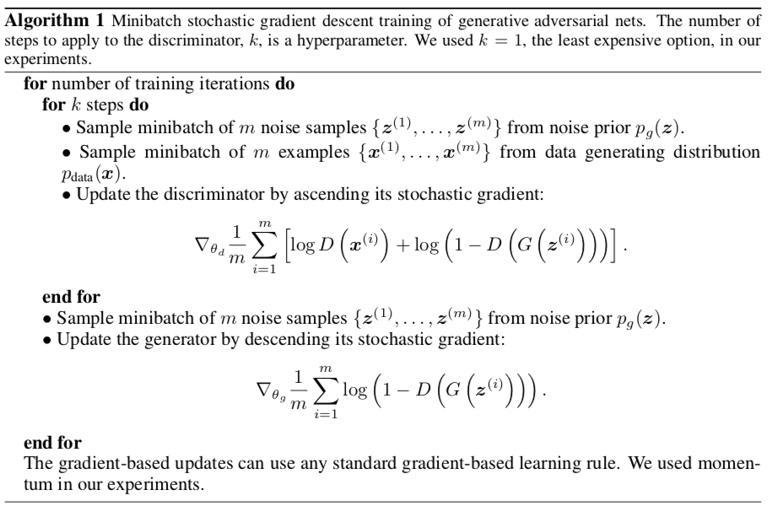
GAN implementation
for i in range(max_train_iters):
random_inputs = torch.randn(fake_sample_num)
with torch.no_grad(): # take G as fixed when training D
fake_samples = generator(random_inputs)
x = torch.cat((train_samples, fake_samples), dim=0)
gnd = torch.cat((ones(train_sample_num),zeros(fake_sample_num)))
# train discriminator
for j in range(2):
pred = discrim(x)
# discriminator loss
loss_discrim = -(pred * (gnd - 0.5) * 2).sum()
…
# train generator
gnd = torch.ones(fake_sample_num)
random_inputs = torch.randn(fake_sample_num).unsqueeze(dim=1)
fake_samples = generator(random_inputs)
output = discrim(fake_samples).squeeze()
# generator loss
loss_gen = - output.mean()
…
I. Goodfellow et al. “Generative Adversarial Nets”, 2014

Slide 21
MOD2: GAN of Images

Slide 22
GAN Framework for images
Generate image data
Transposed Convolution / Upsampling
ResNet Blocks
Batchnorm
Particular Activations
Radfort et al. “Unsupervised Representation Learning with Deep Convolutional Generative Adversarial Networks”
https://arxiv.org/abs/1511.06434

Slide 23
MOD3: Generalised GAN

Slide 24
More GAN Frameworks
The Idea of Using Neural Networks to Supervise Another Neural Network
G: Generate an image
D-1: This should NOT be distinguishable from an artist’s painting
D-2: The features extracted from the image should NOT be distinguished as those extracted from the original image.
Johnson et al. “Perceptual Losses for Real-Time Style Transfer and Super-Resolution”
https://cs.stanford.edu/people/jcjohns/eccv16/

Slide 25
Thanks

